Slide 1

CSSE 374 Software Design Architectural Design

Slide 2
Outline
Why we are learning architecture
Use cases vs user stories vs scenarios
(aka “Is This A Use Case?!”)
Questions on the reading…
Highlights from Ch 2
Levels of design
Architectural drivers
Quality Attribute Scenarios
Design concepts
Example: layered architecture
Design studio: identify elements of architecture.

Slide 3
Why we are learning architecture
“How does code make its way into the master branch?”
A senior project answer I often hear in the Fall:
“We each wrote our part in one day and committed it. Everything broke because we disagreed on what the functions were supposed to be. We spent most of our term rewriting everything to integrate our one day of work. About 5 weeks in, we realized we were using the wrong framework, so we started over. The last day of 10th week, we got login working and wrote some design documentation for the professors to grade.”

Slide 4
Why we are learning architecture
There is a very high cost to a project of not making certain design decisions, or of not making them early enough.
Without doing some architectural thinking and some early design work, you cannot confidently predict project cost, schedule, and quality.
In addition, architecture is a key enabler of agility: if you allow your architecture to degrade, you will be unable to maintain sprint velocity.
What about “The best architectures, requirements, and designs emerge from self-organizing teams”?
Notes:
Rainer Ribback once said to me: “You still need a roadmap, or you’re just plain lost.”
Self-organizing teams must still organize. This simple insight is often lost on people.
Self-organization in agile is not the same thing as willful ignorance of software engineering.
There are well-known ways people begin a big software project. You should read about them.

Slide 5
Why we are learning architecture
Well-designed, properly communicated architecture is key to achieving agreements that will guide the team
Most important kinds to make are agreements on interfaces & shared resources
Architecture will influence, but not determine, other decisions that are not in and of themselves design decisions
E.g. Selection of tools, structuring of development environment

Slide 6
What we did last year instead
Composite lab
Java’s Proxy class
I assert these are somewhat obscure corners of design.
Reading about where to begin is more useful.

Slide 7
Disclaimer
This is a new attempt to expose you to the concepts of software architecture.
By the end of two weeks of study, we hope you will:
Identify the elements of a system’s architecture.
Apply the architecture design process to adapt a system to a new quality attribute.
By senior year: you should say, “Oh hey maybe we should coordinate our work.”
Notes:
We teach a whole 10-week course on Software Architecture.

Slide 8
Use cases vs user stories vs scenarios
I'm not sure I understand the difference between a “(use) case" used for functions and a "scenario" used for quality attributes. Aren't they basically the same thing?
I'm kind of confused as to the difference between use cases and user stories. They seem to accomplish nearly the same thing, and to me the difference almost seems arbitrary. I'm sure there's something I'm missing, though.

Slide 9
Use cases
A sequence of actions a system performs that yield an observable result of value to a particular actor
That means:
A user action must have a system response.
The user does something …
The system displays …
The system response:
Be specific.
Describe something visible to the user.

Slide 10
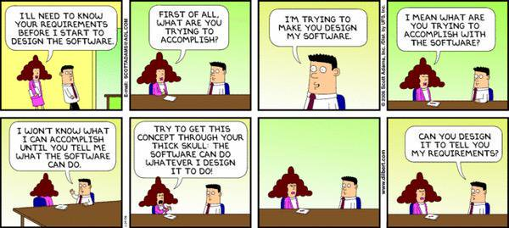
Is this a use case?
A sequence of actions a system performs that yield an observable result of value to a particular actor
Notes:
No! And yet we’ve had students turn in cartoons before, thinking they were use cases.

Slide 11
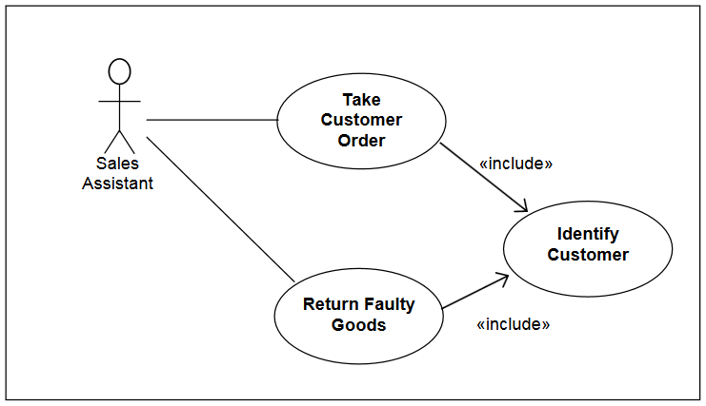
Is this a use case?
A sequence of actions a system performs that yield an observable result of value to a particular actor
Notes:
Students often confuse the use case diagram with the use case itself.

Slide 12
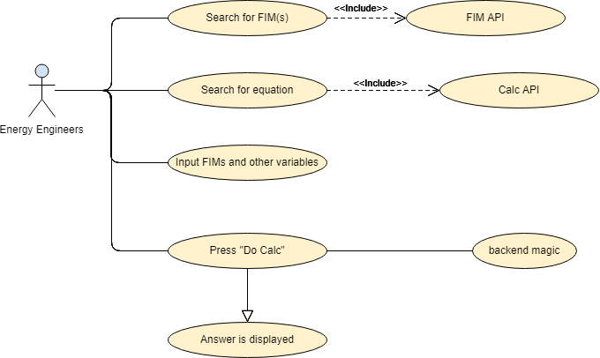
Is this a use case?
A sequence of actions a system performs that yield an observable result of value to a particular actor
Notes:
This is neither a use case nor a use case diagram.
At first glance, this appears to be a use case diagram.
On close inspection: the diagram appears to be made-up process flow syntax for a single use case. The second “level” of arrows show system responses.

Slide 13
Is this a use case?
A sequence of actions a system performs that yield an observable result of value to a particular actor
Use Case: Calculation Administrator
As someone trying to maintain the library of calculations, I need to be able to:
Get a list of calculations
Get an individual calculation
Update a calculation
Make a new (independently tracked) version of a calculation
Create a new calc w/out an original
Update metadata ( ex: contract language)
Notes:
This is closer to a user story.

Slide 14
Is this a use case?
A sequence of actions a system performs that yield an observable result of value to a particular actor
Name: Schedule Appointment
Actors: Patient, Receptionist, Doctor
Description: The system shall allow patients to request doctor's appointments which are then scheduled by receptionists.
Pre/post conditions: ...
Basic flow:
1. Patient requests an appointment from the system
2. Receptionist checks for availability
3. Receptionist schedules the appointment in the system
4. Patient checks in with the receptionist for appointment
5. Doctor assesses the patient
Alternate flows:
…
Notes:
Where is the system response? The “use case without the system response” is the #1 studentism of use cases.
A use case must use a system. This is more of a business process.
The “allow” verb in the Description is the root of the problem. The student did not think about what the system will actually do.

Slide 15
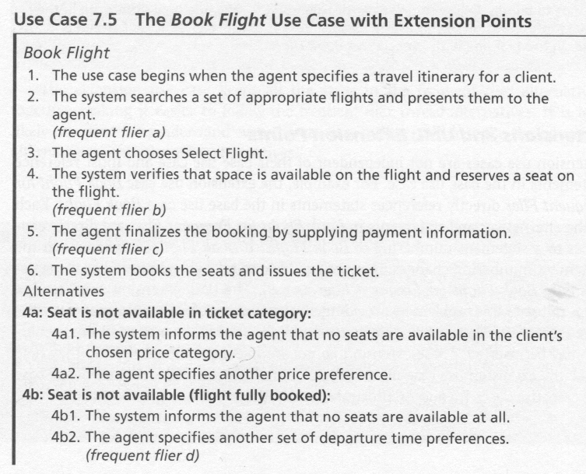
Part of a real use case

Slide 16
A user story is a placeholder
“As a user, I can backup my entire hard drive.”

Slide 17
A scenario is measurable, falsifiable.
“The game shall change view modes in < 500ms when the user presses the <C> button.”
Describes how well the system responds. (ie speed)
You can read more about the structure of scenarios in greater detail on Moodle.
Notes:
The key thing is that the scenario is falsifiable.

Slide 18
Ch1 questions on the reading…
Is using reference architecture common? It seems like something that would make things a lot easier both for the developers and the users.
And if so, are there legal problems that could arise from it? Like if you use a reference architecture and another company uses the same one and your products look really similar, could there be problems there?
Notes:
Yes. In fact it is the easiest way to concisely communicate what the overall design is.

Slide 19
Tactics: common confusion
Are tactics essentially goals that you keep in mind when coming up with the design?
Conceptually, this all makes sense, but could we just revisit patterns versus tactics?
Notes:
No. They are not goals. They are solutions.

Slide 20
What not to do
What are some examples of things people will commonly include in the architecture design phase that they really shouldn’t?
The architect role described seems to be very involved. Is it reasonable for this role to be split up between multiple people/groups?
Notes:
Implementation details.
Do not split the role!
You should have a designated architect who is authorized and accountable to design the system.

Slide 21
How far do you go?
When going through the design phase, how deep will a group go before writing any code? Do they go as far as to do complete UML diagrams?
Notes:
You often write prototype code to determine the soundness/feasibility of an architecture. As far as is needed to determine technical feasibility.

Slide 22
Novel problems vs solutions
It seems that there is a large emphasis on having experience whenever you are designing an architecture. However, I was under the impression that software solutions were supposed to be fairly unique. How often do people find problems where reference architectures and or design patterns don't apply?
Notes:
It is true that we write software to solve novel problems.
But the novel problem we are solving is different from how we solve it.
We often need to do common things, like storing and retrieving data.
Storing and retrieving data is not part of the novel problem you are solving.
In fact, people have given a lot of thought on the topic of storing data.
We can still reuse their approaches while doing novel things.

Slide 23
Alternatives?
What are some alternatives to Attribute Driven Design? It seems like a very standard cycle and I can see why it would be successful, but what other strategies are used in the real world?
Rational Unified Process
Siemens’ 4 Views
Business-Architecture-Process-Organization
Architectural Separation of Concerns
Scaled Agile Framework
Notes:
Each of these was proposed to solve deficiencies in some other architectural design process.
I would rather we study one process.

Slide 24
Ch 3 Questions on the reading…
This is a lot of new terminology; are we going to have to memorize all of these?
Can we go over some of the basic terms to ADD? I'm still pretty confused on the differences between terms like elements and modules, as well as architectural and design concepts, patterns, and structures. When is something considered part of the architecture process in regards to design, and when is it not?
Notes:
You tell me. Do you enjoy the prospect of embarrassing yourself in front of your coworkers with your lack of knowledge of software engineering?
I want you to feel conversant in this terminology.
Merely knowing what the terms mean is not sufficient, but it is a good first step.

Slide 25
Some terminology
Elements: generic term for the things that your architecture draws arrows between.
Not necessarily atomic!
Modules: logical grouping of code you will write. For example: “PlantUML Converter”
Modules are elements.
Drivers: problems you are solving
Design concepts: common solutions
Structures: your instantiation of the common solutions

Slide 26
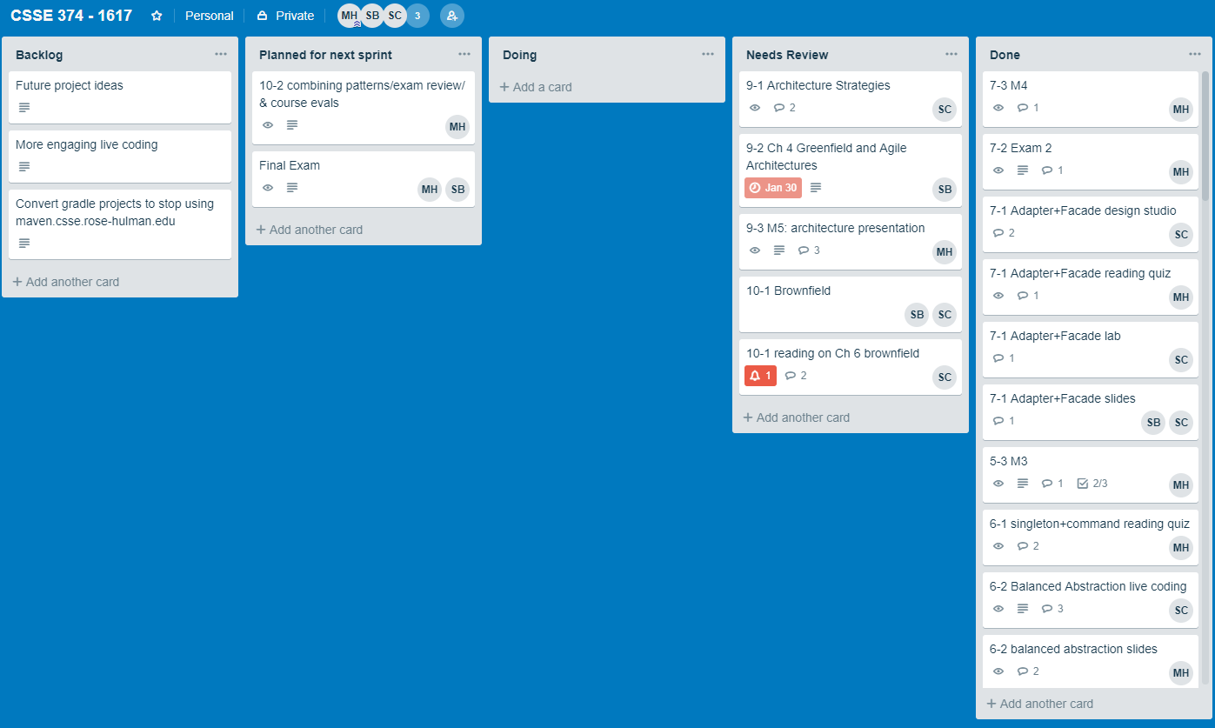
Kanban?
Is Kanban essentially the same as Trello?
Notes:
Yes. Kanban is Japanese for “Trello board.”

Slide 27
ADD vs Agile?
Can you explain a little more about why the documentation required for ADD is not as loose as Agile? I know the question gave the example on pg 68, but other than that it seems like it would be pretty loose?
Notes:
Because you must know up front what the important quality attributes are, which often

Slide 28
Agile manifesto
We are uncovering better ways of developing
software by doing it and helping others do it.
Through this work we have come to value:
Individuals and interactions over processes and tools
Working software over comprehensive documentation
Customer collaboration over contract negotiation
Responding to change over following a plan
That is, while there is value in the items on
the right, we value the items on the left more.
Notes:
Suppose we just said that this was our software process.
How might ADD seem antithetical to agile?

Slide 29

“Too Much Documentation” meme
Do you have any examples of problems caused by over documentation of architecture?

Slide 30
“Too Much Documentation” meme
“The first time I was technical project lead I was on the CMM trip. I made the team gather requirements, writing them down with reference numbers, then make an x-hundred pages specification and so on. We instrumented all the stuff and I think, the project extrapolated to a complete organization would have well reached CMM level 3. My main part was the architecture. I sat down with the team for nearly half a year, sketching object designs on the whiteboard, writing it down in a document, refining it, writing it down, refining it, and so on. In the end we had a 120 page architecture document which was quite sound - but not a single line of code.
Guess, how the story goes on: We were late (of course) and expanded the team. The new team members managed to get into the ideas in a very short time, because we had great documentation. Yet, we were not able to meet reasonable time-to-market requirements and half a year later the project was canceled.”
http://wiki.c2.com/?TooMuchDocumentation

Slide 31
Last question: you tell me
Overall, how well do the term projects follow good architecture practices?
Notes:
Have you been following these practices in the creation of your systems?

Slide 32
Highlights of Ch 2
The main confusing parts

Slide 33
Highlight #1: Levels of Design
Architectural Design: Design of structures that allow drivers to be satisfied
Element Interaction Design:
Identification of additional elements and their interfaces
Element Internals Design:
What is each thing, in summary?
Notes:
Distinctions between high vs low-level design are ambiguous and confusing.
These are more precise.

Slide 34
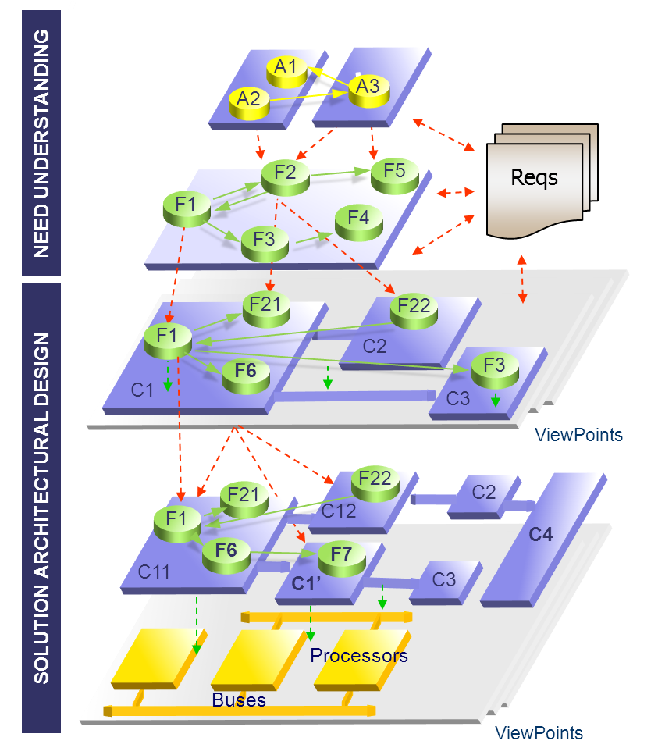
Highlight #2: Architectural Drivers
Design purpose
Quality attributes
Primary functionality
Architectural concerns
Constraints
Notes:
“The requirements drive the architecture.”
But there might be things not captured by the requirements – that’s what the architectural concerns are.
Example: DST, leap year.

Slide 35
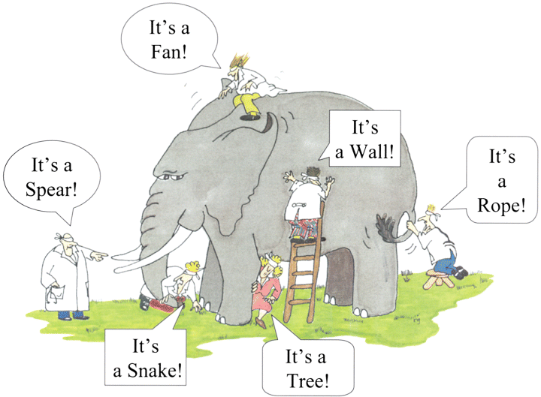
Quality Attributes
Measurable/testable system properties used to indicate how well the system satisfies the needs of its stakeholders.
CSSE371 list of these on Moodle.
Notes:
Quality attributes significantly shape the architecture

Slide 36
Highlight #3: Quality Attribute Scenario
Meaningless to say a system will be “modifiable”
Quality Attribute Scenario: short description of how system required to respond to some stimulus
Performance scenario: the game shall change view modes in < 500 ms when the user presses the <C> button”
Notes:
It is meaningless to say that a system will be “modifiable”, because every system is modifiable with respect to some changes and not modifiable with respect to others. One can, however, specify the modifiability response measure you would like to achieve (say, elapsed time or effort) in response to a specific change request.

Slide 37
6 Parts of a Quality Attribute Scenario

Slide 38
6 Parts of a Quality Attribute Scenario
The game shall change view modes in < 500 ms when the user presses the <C> button”
Game
<C>
Change
view
modes
Normal
User
< 500 ms
Notes:
The key thing is that the scenario is falsifiable.

Slide 39
Prioritizing Scenarios (see RICE)
To prioritize scenarios, consider two dimensions of each scenario and assign a rank of importance:
Importance
Technical risk
A low/medium/high (L/M/H) scale is used to rank both dimensions
Once the dimensions have been ranked, scenarios are prioritized by selecting those that have a combination of (H, H), (H, M), or (M, H) rankings
Do not start design without a prioritized list of measurable quality attributes!
Notes:
Importance assigned by client, risk assigned by you.
We used RICE in 371.

Slide 40

Highlight #4: Design Concepts
Building blocks from which the structures that make up the architecture are created
Some of the most commonly used:
Reference architectures
Deployment patterns
Architectural patterns
Tactics
Externally developed components
Notes:
I thought design concepts were well explained, but I want to use this time to further emphasize them

Slide 41
Reference Architectures
Blueprints that provide an overall logical structure for particular types of applications
Web application
Mobile application
Lambda architecture
Example reference architecture for the development of web applications from the Microsoft Application Architecture Guide (Key: UML)

Slide 42
Architectural Design Patterns
Design patterns are conceptual solutions to recurring design problems that exist in a defined context
There are catalogs with patterns that address:
Decisions at varying levels of granularity
Quality attributes such as security or integration
Example of Layered Architecture

Slide 43
Deployment Patterns
Deployment patterns provide models on how to physically structure the system to deploy it

Slide 44
Tactics
Techniques that architects have been using for years to manage quality attribute response goals
Design decisions that influence the control of a quality attribute response
Example of Performance Tactics

Slide 45

Externally Developed Components (1 of 2)
Patterns and tactics are abstract in nature, they need to be implemented
Two ways to achieve this:
Code the elements obtained from tactics and patterns
Associate technologies with one or more of these elements in the architecture
Consider technologies to be externally developed components, because they are not created as part of the development project

Slide 46
Externally Developed Components (2 of 2)
Technology families. A technology family represents a group of specific technologies with common functional purposes. Example: Frameworks like Rails
Products. A product (or software package) refers to a self-contained functional piece of software that can be integrated into the system that is being designed and that requires only minor configuration or coding. Example: MySQL
Application frameworks. An application framework (or just framework) is a reusable software element, constructed out of patterns and tactics, that provides generic functionality addressing recurring domain and quality attribute concerns across a broad range of applications. Example: Guice
Platforms. A platform provides a complete infrastructure upon which to build and execute applications. Example: Google Cloud

Slide 47
Externally Developed Components Selection
Can be a challenging task because of their extensive number. Some criteria include:
Problem that it addresses
Cost
Type of License
Support
Learning curve
Maturity
Popularity
Compatibility and Ease of Integration
Support for Critical Quality attributes
Size

Slide 48

Architecture Design Decisions
Design is the process of making decisions about implementation
Experienced architects, when faced with a design challenge, typically entertain a set of “candidate” decisions; from this set, they choose a best candidate
In the early stages of design, decisions focus on the biggest, most critical choices that will have substantial downstream consequences

Slide 49
Your book is a great starting point
Appendix A: A Design Concepts Catalog
Reference Architectures
Deployment Patterns
Architectural Design Patterns
Tactics
Externally Developed Components
Appendix B: Tactics-Based Questionnaires
Using the Questionnaires
Availability
Interoperability
Modifiability
Performance
Security
Testability
Usability
DevOps
It gives you enough info to determine whether a topic is something you want to read more about elsewhere.
Notes:
A: the names of the patterns themselves.
B: lists of questions you can ask yourself to see if you are using best-practices.

Slide 50
Concluding Thoughts
Architectural design is important because it is the embodiment of early, far-reaching, hard-to-change decisions.
Requirements and technical risk drive architecture.
Scenarios from CSSE371 convey quality attributes in a testable manner.
Design concepts are the building blocks of design.
Appendices A & B contain excellent “search terms.”

Slide 51
Layered architecture

Slide 52

UML Architectural Views
Logical Architecture – describes the system in terms of its organization in layers, packages, classes, interfaces and subsystems
Deployment Architecture – describes the system in terms of the allocation of processes to processing units and network configurations
Notes:
A layer is a coarse grained grouping of classes packages or subsystems that has cohesive responsibility for a system aspect
Higher layers call upon the services of lower layers

Slide 53
Logical Architecture
Large-scale organization of the software classes into:
Packages (a.k.a., namespaces)
Subsystems
Layers
Logical, since implementation/deployment decisions are deferred
Notes:
Q8: The large-scale organization of software classes into packages, subsystems, and layers is called the system’s logical _Architecture__.

Slide 54
Layered Architectures
Very common for object-oriented systems
Coarse-grained grouping of components based on shared responsibility for major aspects of system
Typically higher layers call lower ones, but not vice-versa

Slide 55
Three Typical Architectural Layers
User Interface
Application Domain Layer
Technical Services:
Persistence
Logging
Rules Engine
Heavily influenced by domain model
Reusable across systems
Notes:
Q9: List some layers that typically occur in object-oriented systems

Slide 56
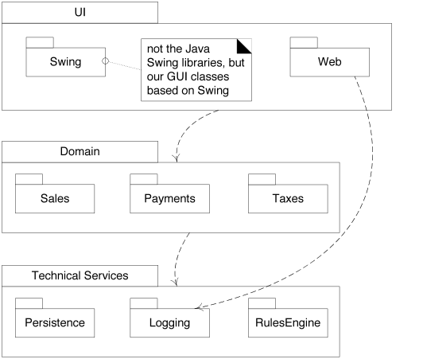
Strict vs. Relaxed Layered Architectures
Strict: only calls next layer down
Relaxed: can call any layer below
Notes:
- Which is this? (relaxed, Web calls Logging)
Eventually we’ll see that “call” is an overstatement. We really mean “depend on”. Different patterns will let us have lower levels communicate to higher ones without depending on them.
Q10: What’s the difference between a strict and a relaxed layered architecture?

Slide 57
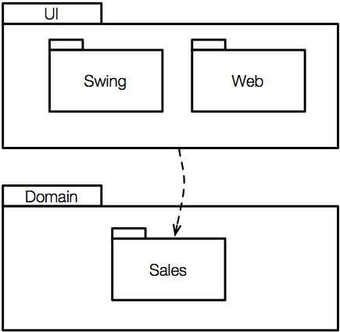
UML Package Diagrams
Package Names
Describes grouping of elements
Can group anything:
Classes
Other packages
More general than Java packages or C# namespaces
Dependency Line
Fully qualified name is: Domain::Sales
Notes:
Q2: True or false (circle one): UML package diagrams only show the grouping of classes.

Slide 58


Designing with Layers Solves Problems
Rippling source code changes
Intertwining of application and UI logic
Intertwining of application logic and technical services
Difficult division of labor
Notes:
Q4: List four problems that are mitigated by using a layered architecture. [Rippling source code changes, Intertwining of application and UI logic, Intertwining of application logic and technical services, Difficult division of labor]
- i.e., a change in one requirement causes changes to most of the classes in the system
- e.g., prevents changing of the UI
- e.g., prevents plugging in new technical services (e.g., cloud-based storage)
different teams can work on different layers

Slide 59
Benefits of Architecture Layers
Separation of concerns
Reduces coupling and dependencies; improves cohesion; increases reuse potential and clarity
Essential complexity is encapsulated
Can replace some layers with new implementations (e.g., platform independence)
Can distribute some layers
Can divide development within/across teams

Slide 60
Common Layers in More Detail (1 of 2)
Notes:
Q5: For each of the following common layers in a layered architecture, give an example. The first one is done for you: [Application: server-side interface to clients in web-based system (session state); Domain: services like POS or billing; Technical services: persistence (database), rules engine]
APP- server-side interface to clients in web-based system (e.g., session state)
Domain- models the problem domain
Business Infr.- high-level reusable infrastructure (e.g., currency conversion, sales tax)

Slide 61
Common Layers in More Detail (2 of 2)
Systems will have many, but not necessarily all, of these
Notes:
Continued from previous page…gray area
- medium-level reusable infrastructure (e.g., persistence, security)
low-level reusable infrastructure (collection classes, math, network and file I/O)
Q5: For each of the following common layers in a layered architecture, give an example. The first one is done for you:

Slide 62
Design studio

